Slide 1
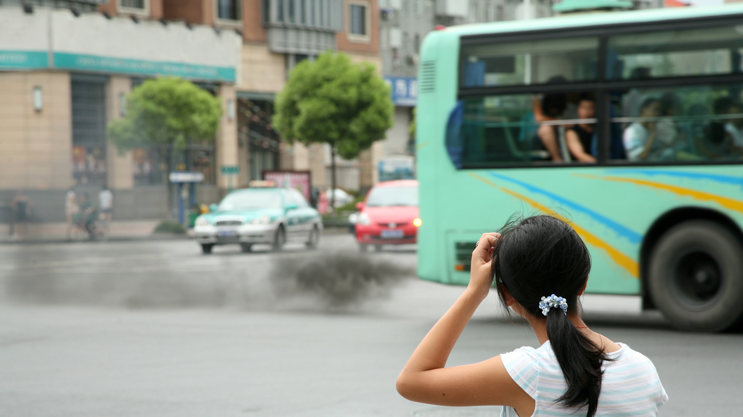
Clean Air Zones
(CAZs)

Slide 2
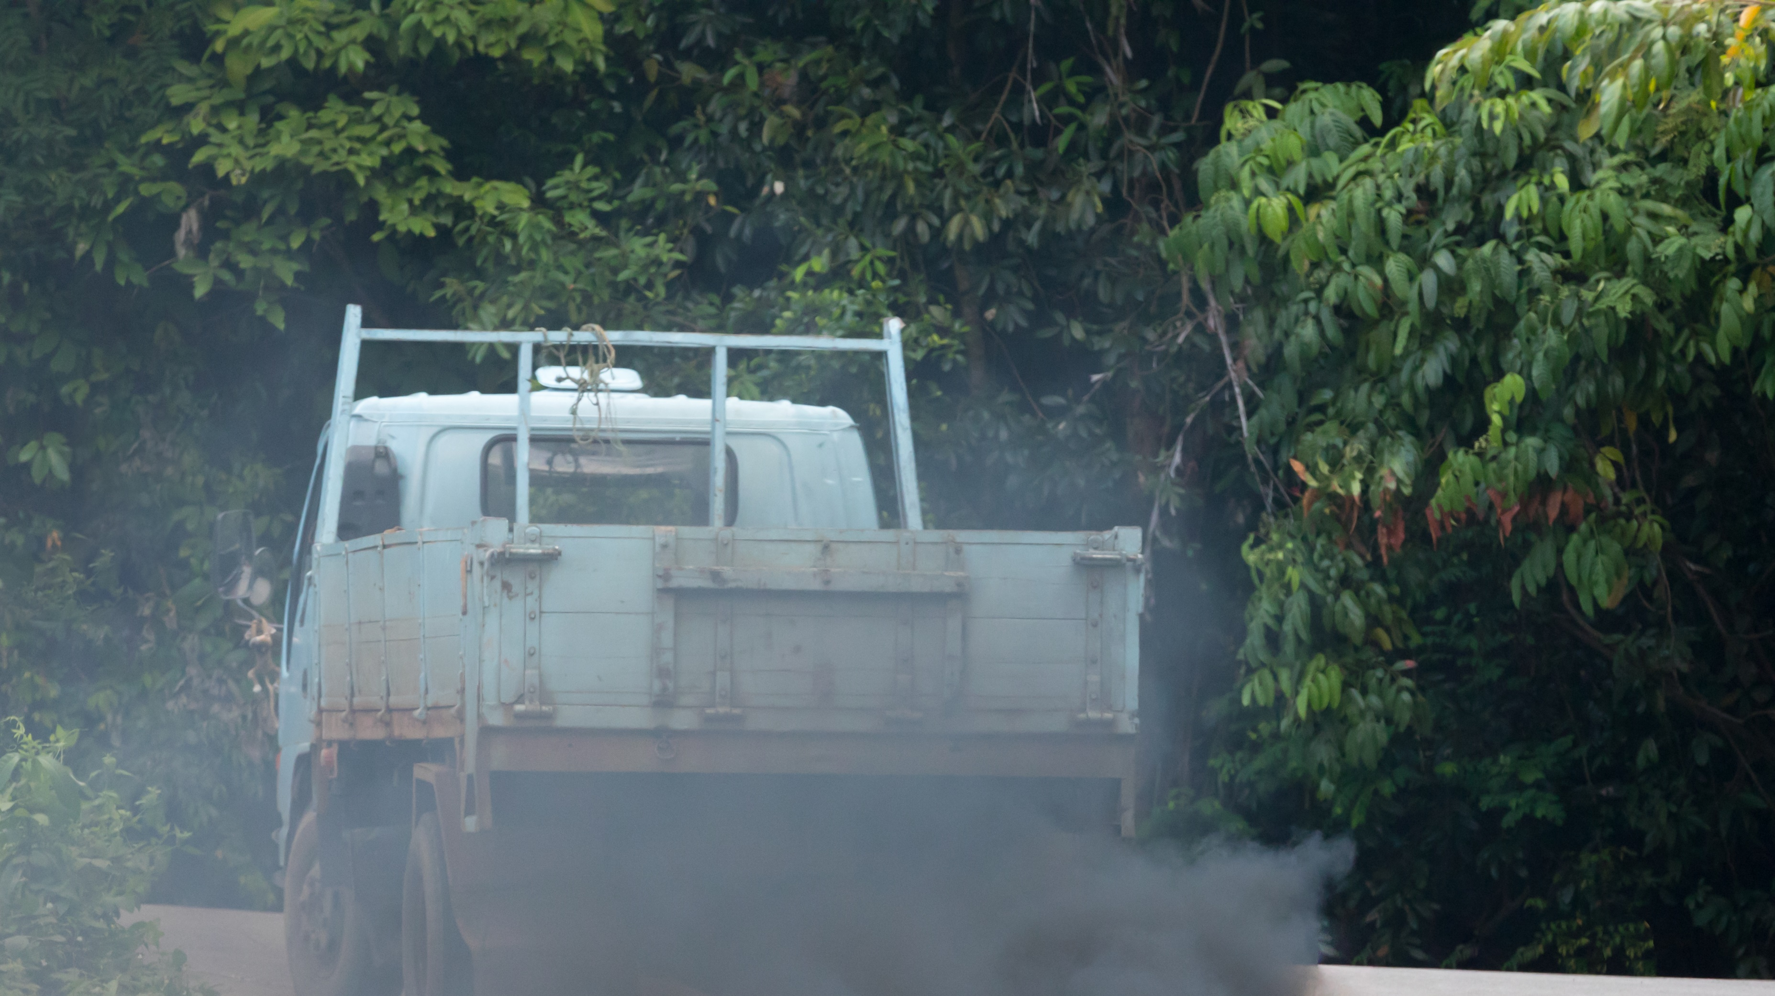
Clean Air Zones
(CAZs)
Live…
Bath: 15th March 2021
Birmingham: 1st June 2021
Portsmouth: 29th November 2021
Bradford: 26th September 2022
Bristol: 28th November 2022
Newcastle and Gateshead: 30th January 2023
Sheffield: 27th February 2023
Going live…
Great Manchester: under review

Slide 3
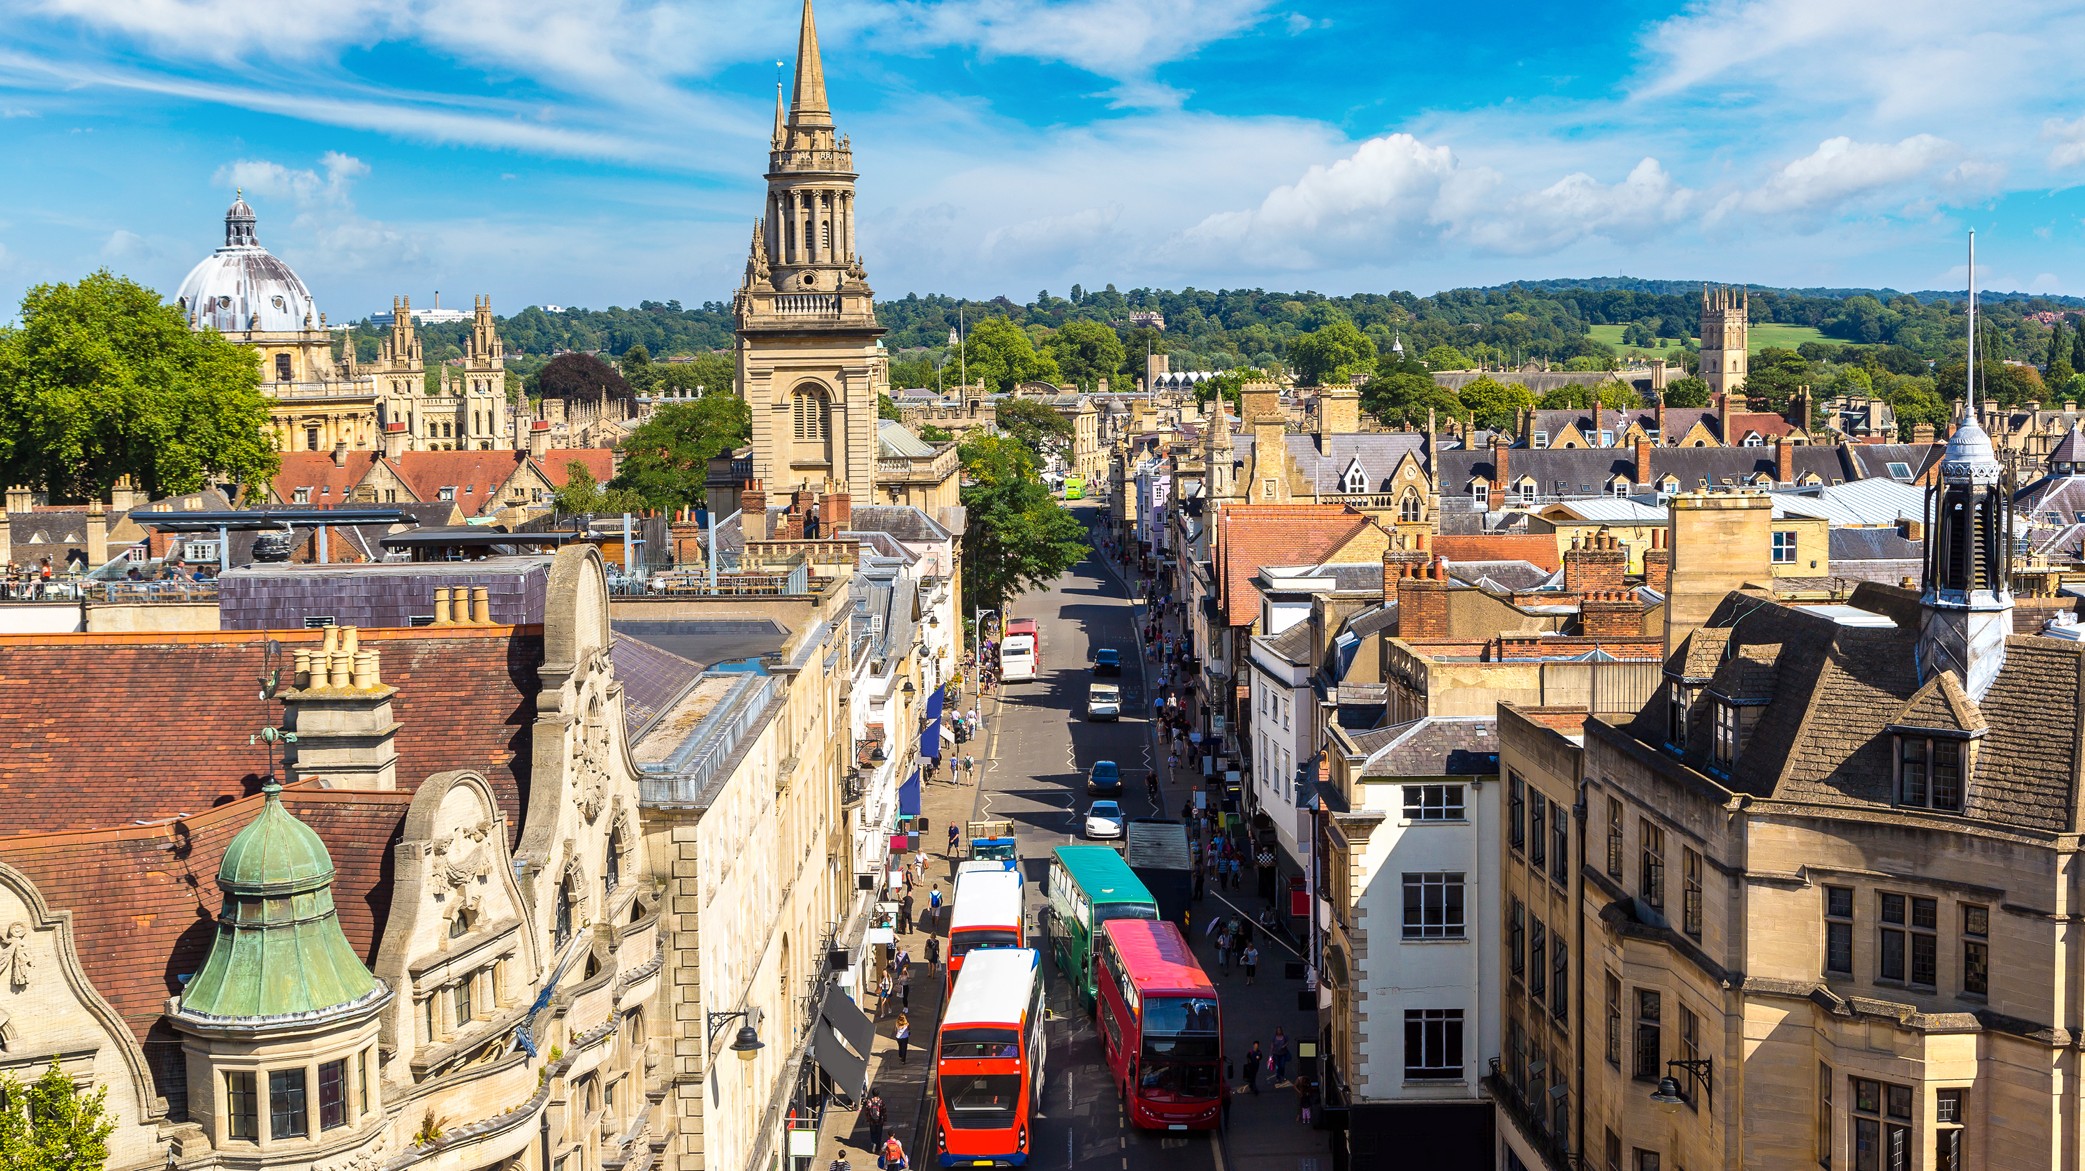
What is the cost?
Penalties £50-£100
Funding available – upgrading/retrofitting
Right to appeal

Slide 4
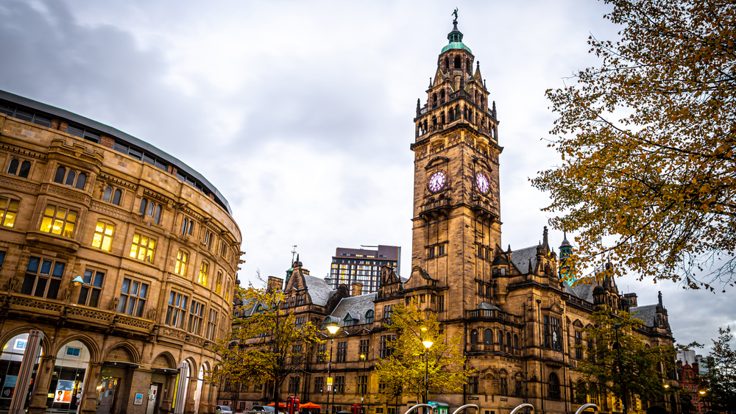
Right to challenge
Exemptions – national and local
Raise challenges
Right to appeal

Slide 5
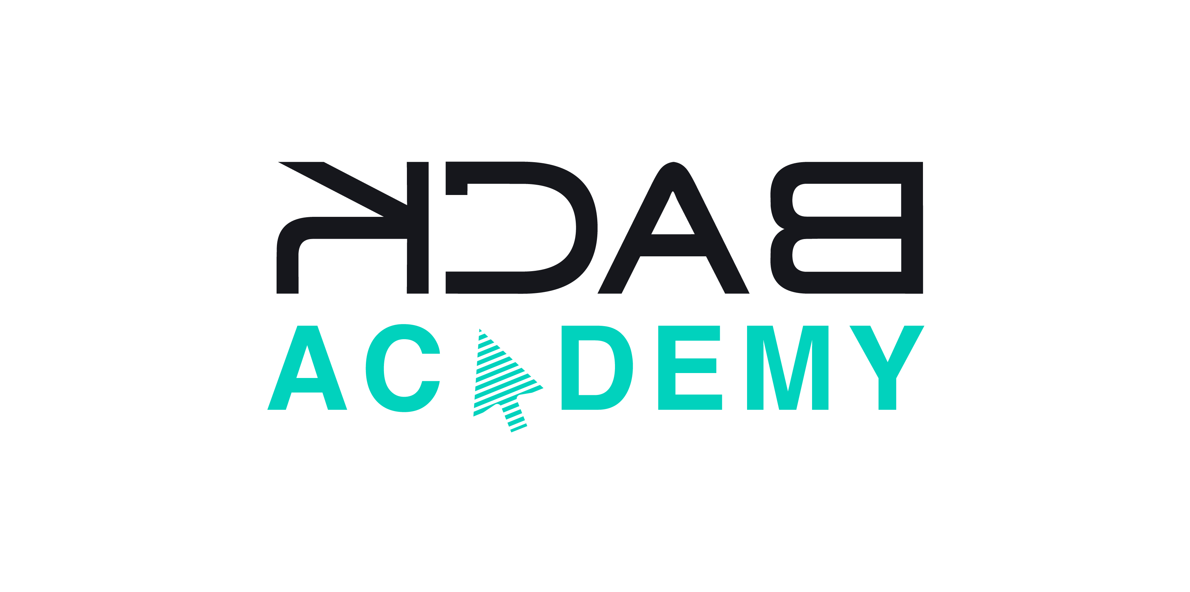
Join our Training
8 March: Bridge Strikes
8 March: Brake Testing
16 March: OLAT
22/23 March: 2-Day TM Refresher
28 March: Drivers’ Hours & Tachographs
13 April: Bus Reliability and Punctuality
25/26 April: 2-Day TM Refresher
27 April: OLAT

Slide 6
Libby Pritchard
Associate Director Backhouse Jones
E: libby.pritchard@backhouses.co.uk
T: 01254 828300

