Slide 1
Warehousing and fulfilment: Opportunities, challenges and support
Jonathan Walker
Head of Cities and Infrastructure Policy, Logistics UK
Notes:
Hi everyone and thank you for the opportunity to speak today.
Before I start, a little about me and Logistics UK
Logistics UK is one of the country’s largest business groups, supporting, shaping and standing up for safe and efficient logistics. We are the only organisation representing the entire logistics sector. We represent a sector delivering an increasingly innovative, productive and sustainable system of essential national infrastructure. This system ensures the availability of the products that households, businesses and public services rely on every day, and is supporting the UK’s transformation for the future. Our membership of over 20,000 includes global, national and regional businesses and SMEs spanning the road, rail, sea and air industries as well as the buyers of freight services, such as retailers and manufacturers.
I joined in December to lead all of our work nationally on issues relating to infrastructure, planning and the physical environment our members operate in.
Today is going to be a very quick run through of what we see is happening in this space and where we think policy ought to go next in order to support the growth of our sector.

Slide 2
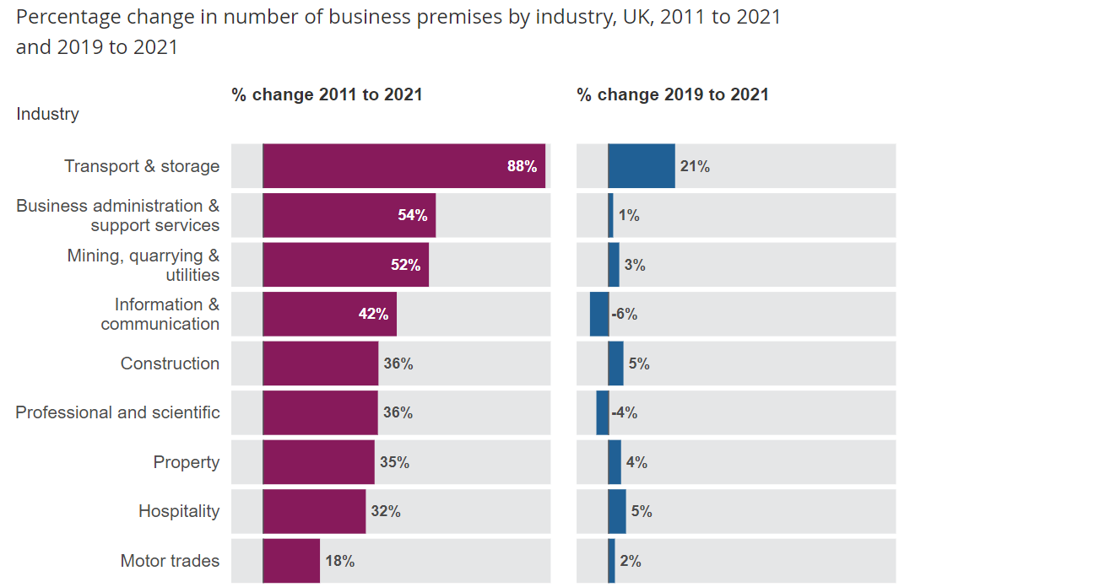
Trends and opportunities
Source: ONS The rise of the UK warehouse and the “golden logistics triangle”
Notes:
This slide probably tells you something you all know, but we have seen a remarkable rise in demand for, and use of land and property for logistics and warehousing purposes.
Obviously this data is pre-pandemic, and we have likely witnessed a slow-down, but the importance of our sector has never been more prominent in the public consciousness. Changes in consumer and commute habits are ever-chainging but we are not going back to the patterns witnessed pre-pandemic. This is going to continue to present challenges and opportunities for the sector.

Slide 3
Trends and opportunities
Construction News: “Demand for warehouse construction soars”
Financial Times: “Warehouse demand rages on despite Amazon pullback”
The Grocer: “Demand for warehouse space continues to outstrip supply, driving up rents”
Notes:
And as we all know, all of this have placed pressures and premiums on high quality sites suitable for logistics operations. This is backed up by the conversations we have regularly with members who, despite recent economic challenges, foresee plenty of opportunities for growth, accompanied by continued changes in the types of sites sought – with an increasing emphasis on modern, flexible spaces with room for expansion and innovation, compared to the older sheds they may currently occupy

Slide 4
Issues
Skills
HGV drivers
Operatives
Planning & supply
Land allocation
Local inconsistency
Decarbonisation
Fleet transition
Key skills (e.g. fork lift)
Connectivity
Self-generation
Grid access
Notes:
Longer term, where is the sector heading? This isn’t all doom and gloom, but in many cases is a sign of the industry facing up to broader societal challenges

Slide 5
Solutions and interventions
Skills
Apprenticeship Levy reforms
Planning & supply
NPPF reforms
Greater planning authority awareness
Decarbonisation
Feed-in
‘Future of Freight’: National Freight Network
Permitted development
Grid connection support
Generation Logistics
Notes:
NPPF response:
Logistics and new developments: when planning and approving new housing and commercial developments, the requirements of logistics should be as intrinsic as considerations for essential amenities such as gas, electricity and public transport. Practical considerations include connectivity to strategic freight networks, access to distribution hubs and opportunities for freight consolidation. Alternative fuels and decarbonisation: the logistics industry is both aware and supportive of the need to transition away from fossil fuels and has already taken great strides in reducing emissions. To give industry even greater confidence to invest, a transformational approach is needed to support the development of charging and refuelling infrastructure. This will require a planning environment that encourages and, where appropriate, mandates such infrastructure. Similarly, we urge Government to review policy to facilitate greater decarbonisation of logistics facilities. This would include a revision of permitted development rights to make it easier to install renewable energy generation or charging points at warehouses and depots and a far greater onus on distribution networks to support such investment. Safeguarding land: logistics land must be safeguarded, whether it is used for warehousing, depots, rail terminals, riverside wharves or any other purpose. Land should also be protected for urban logistics centres, to ensure they are not pushed further out of towns and cities. Agent of change: we support this principle whereby new residential developments that are, for example, constructed next to existing industrial or logistics sites must design in features to prevent new residents from nuisances such as noise, odours and dust. Modal shift: the planning system can support modal shift through efficient and effective decision making. Delays or problems relating to developments such as rail interchanges or wharves cause delays and disincentives to shifting from road to rail and water. 2 Planning and congestion: passenger cars are the predominant contributor to congestion, yet too often we see freight vehicles becoming the primary target of anti-congestion measures. Given the economic importance of road freight traffic, Government and planning authorities must focus on keeping it moving. Planning proposals should be critically assessed on their impact on freight movements, with far more emphasis being placed on enabling and encouraging mode and habit shift for passenger traffic

Slide 6
Questions
jwalker@logistics.org.uk

