Slide 1
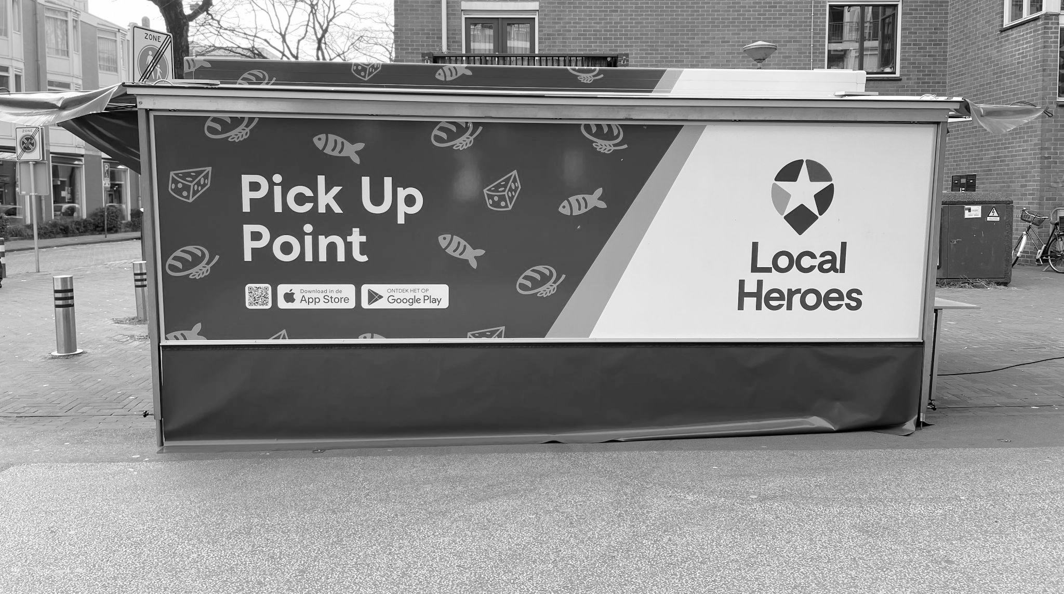
Sandra Rothbard, AICP
Urban planning freight consultant
Notes:
Hard to discuss everything in a short time period
Sandra Intro of self

Slide 2
Curb Management ▪ Consolidation ▪ Routing
Land Use ▪ Environmental Justice ▪ Multi-modal
Complete Streets ▪ Tech Innovation
Zero-Emission Zones ▪ Warehousing / Fulfillment

Slide 3
Consultation & Advisory Services
Research
& Project Management
Community & Stakeholder Engagement

Slide 4
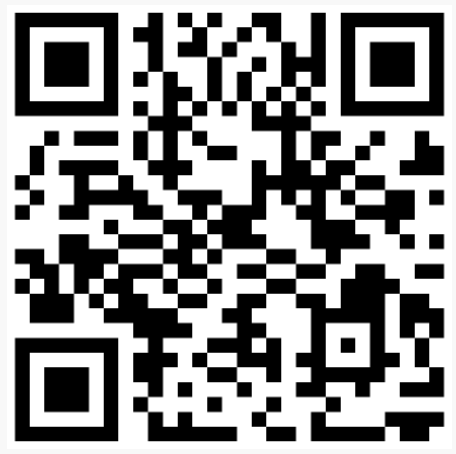
Sandra Rothbard, AICP
sandra@freightmatters.org
www.freightmatters.org
@freight_matters
Handling of unsold items

